Slide 1
Self Explaining Model
Shao Wei

Slide 2
Self-Explaining Structures Improve NLP Models

Slide 3
Motivation
Drawbacks of Explaining Methods
the main model and the explaining model are decoupled: existing explaining models are not self-explainable
the probing model is only able to explain a model’s predictions by operating on low-level features by computing saliency scores for individual words but are clumsy at high-level text units such as phrases, sentences, or paragraphs
Propose a Self-Explaining Framework
Put an additional layer on top of any existing NLP Model
layer aggregates the information for each text span, which is then associated with a specific weight, and their weighted combination is fed to the softmax function for the final prediction

Slide 4
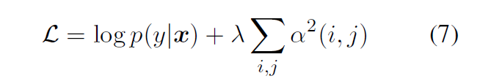
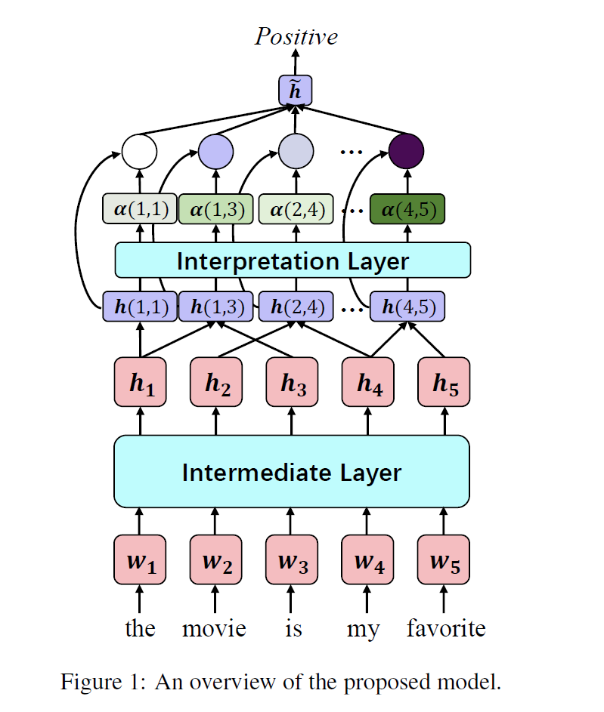
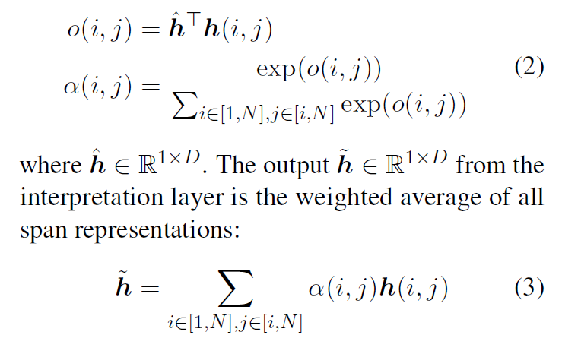

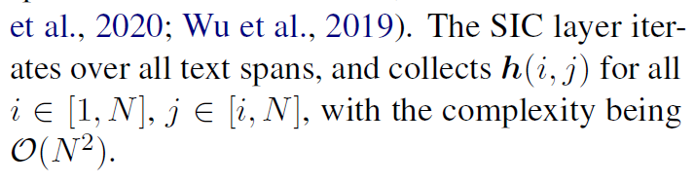
Methods

Slide 5
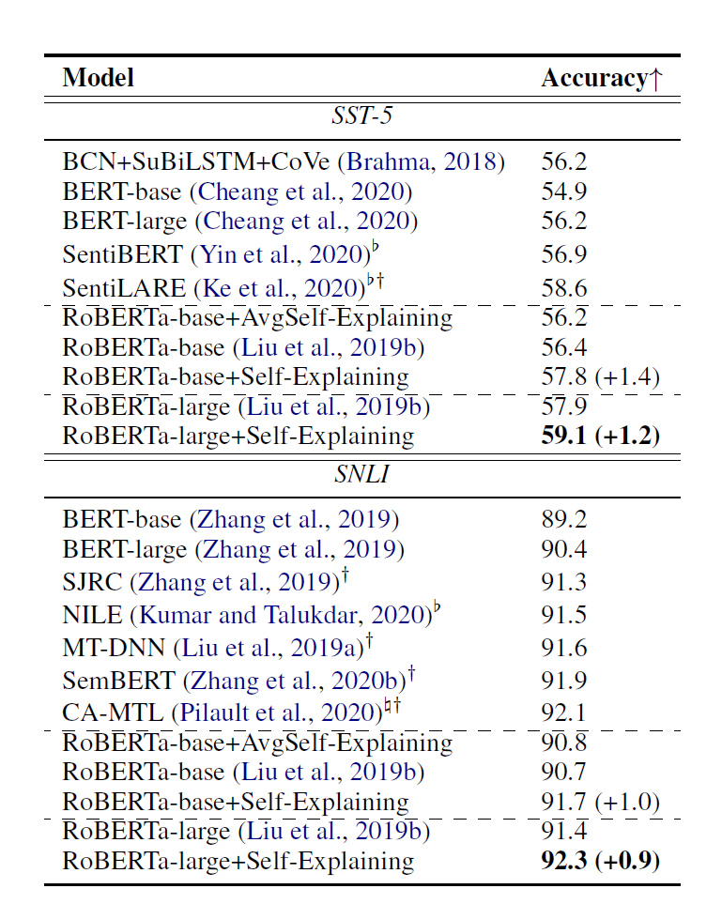
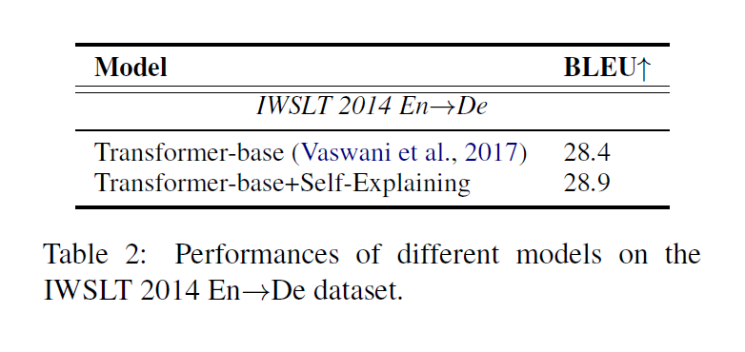
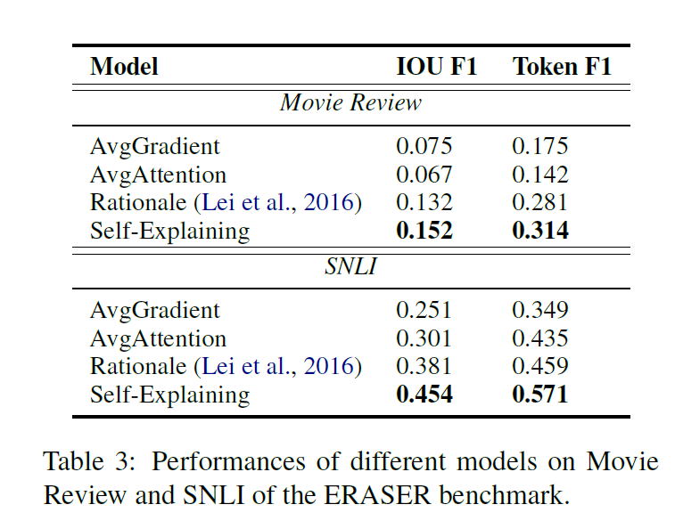
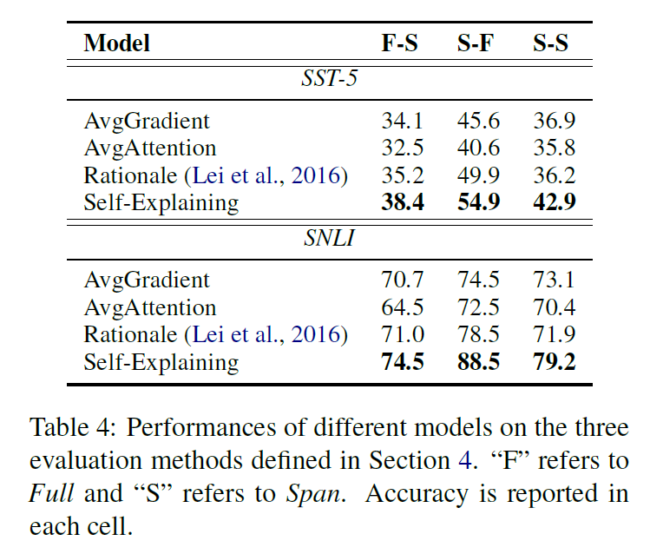
Part Results

Slide 6
Summary
New Layer for Explanation
High-level Explanation Base
Explanation as Regularization
Evaluation of Explanation

Slide 7
ProtGNN: Towards Self-Explaining Graph Neural Networks

Slide 8
Motivation
Drawbacks
Existing explanation methods mainly focus on post-hoc explanations where another explanatory model is employed to provide explanations for a trained GNN
Post-hoc methods fail to reveal the original reasoning process of GNNs raises the need of building GNNs with built-in interpretability
Propose Prototype Graph Neural Network
Combines prototype learning with GNNs and provides a new perspective on the explanations of GNNs
Explanations are naturally derived from the case-based reasoning process and are actually used during classification

Slide 9
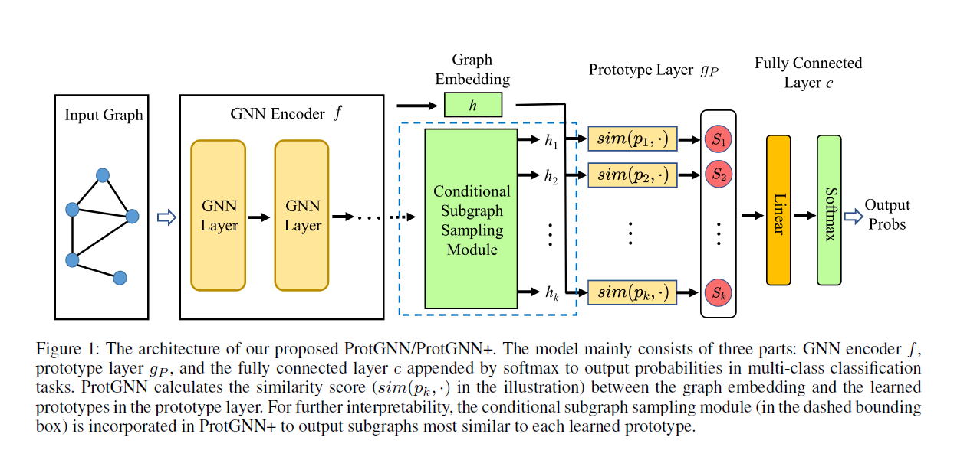
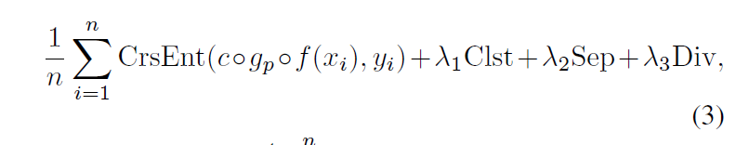
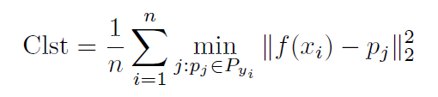
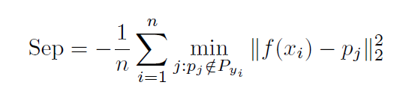
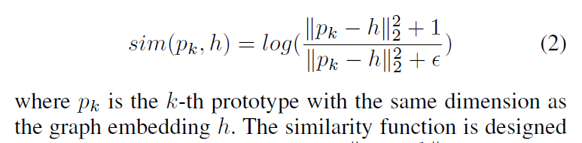
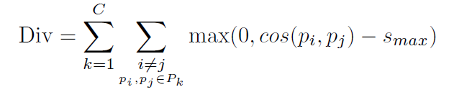
Model

Slide 10
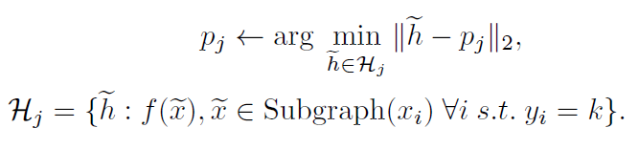
Model
The learned prototypes are embedding vectors that are not directly interpretable
Project each prototype onto the nearest latent training subgraph with the same class
Employ the Monte Carlo tree search algorithm (MCTS) as the search algorithm to guide our subgraph explorations

Slide 11
Model
Not only show the similarity scores to prototypes, but also identify which part of the input graph is most similar to each prototype as part of the reasoning process
Conditional subgraph sampling module outputs different subgraph embeddings for each prototype

Slide 12
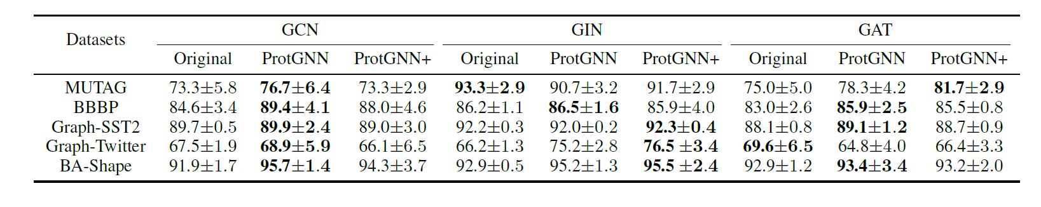
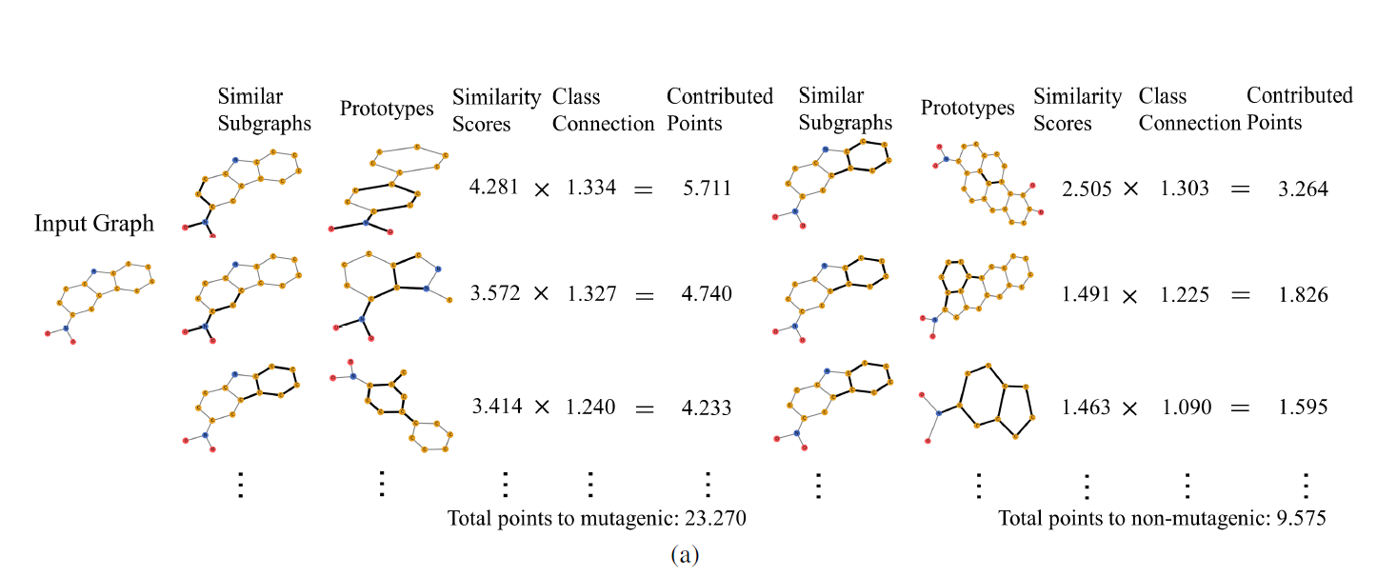
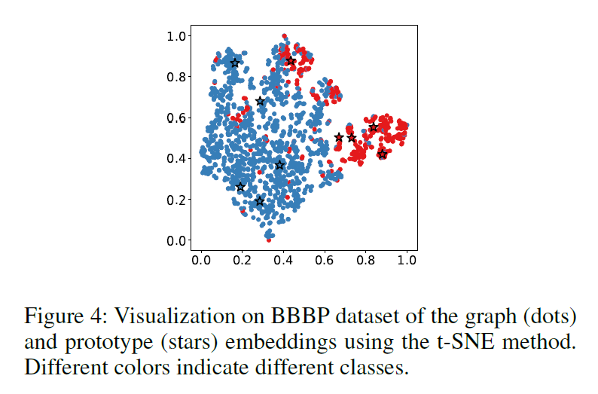
Part Results

Slide 13
Summary
Prediction on a new input graph is performed based on its similarity to the prototypes in the prototype layer
Employ the Monte Carlo tree search algorithm to efficiently explore different subgraphs for prototype projection and visualization.
Design a conditional subgraph sampling module to identify which part of the input graph is most similar to each prototype for better interpretability and efficiency.

Slide 14
Generalizable and Explainable Dialogue Generation via Explicit Action Learning

Slide 15
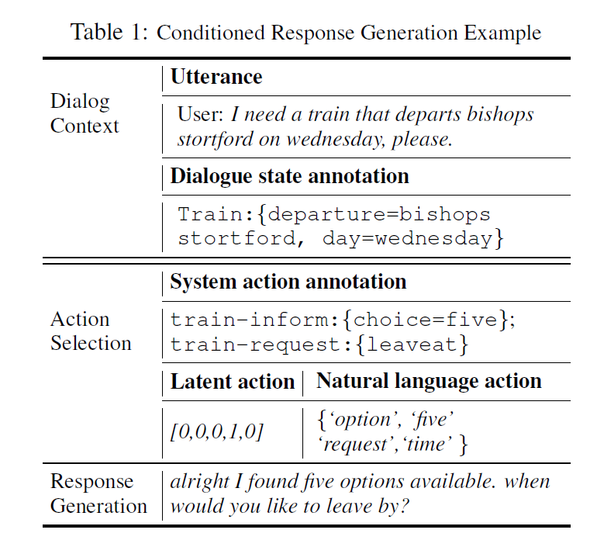
Task Definition
Conditioned response generation
an action is first selected
usually rely on action annotations
an utterance is generated
conditioned on this action
Goal
Informative
Naturally sound

Slide 16
Motivation
Conditioned generation relies on action annotations
Latent Action Learning
System utterances are represented as low-dimensional latent variables by an auto-encoding task
Generalization (VAE tends to produce balanced distribution, while the true one is usually not that)
Natural Language Actions
Represent system utterances as a span of words, obtained by identifying salient words of system utterances
Notes:
Salient refers to indicative for a prediction task

Slide 17
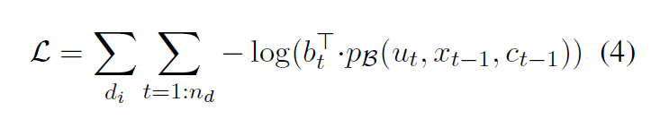
Methods
Construct salient words
Measure word saliency in terms of state transition
Train a dialogue state tracking model that takes as input the system utterances
Regard the sequence of words that substitute the system utterance and get similar state tracking results as salient words

Slide 18
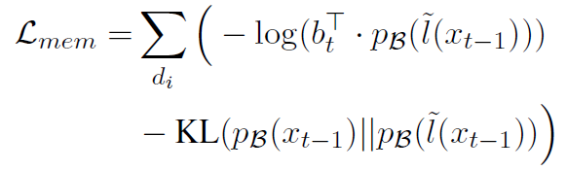

Methods
Construct salient words
Use a learnable memory component that stores all potential words to form action representations, and optimize the memory in a self-supervised way.
Use each system utterance as a query to perform memory retrieval, and the retrieval results are considered as salient words

Slide 19
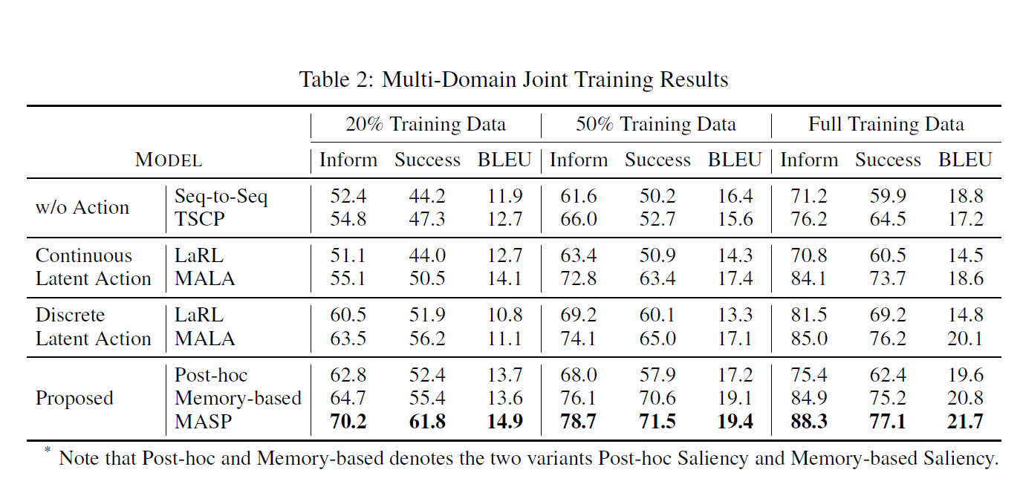
Part Results

Slide 20
Summary
Explanation base
Dialogue Action
A new task related to explicit actions
DST
Memory-based Retrieval to obtain Actions
Optimization
Self-supervised

